Slide 1
Chapter 1 and 2
Atoms, Periodic table and Radioactivity
Atoms and the Periodic Table
Models of the Atom
Atomic Notation
Radioactivity and Radioisotopes
Nuclear Equations and Radioactive Decay
Radiation Units and Half-Lives
Medical Applications for Radioisotopes

Slide 2
Atoms and the Periodic Table
A table that arranges the elements in order of atomic number with elements with similar properties in the same column
Periods: Horizontal rows in the periodic table
Groups (or Chemical Families): Vertical columns in the periodic table
The elements in the periodic table are divided into three groups—metals, nonmetals, and metalloids.
Learn the names and symbols of the1st 36 elements + Rb, Sr, Cs, Ba, Ra, Zr, Ag, Cd, Sn, Sb, Te, I, Xe, Pt, Au, Hg, Pb, Bi, Rn, U

Slide 3
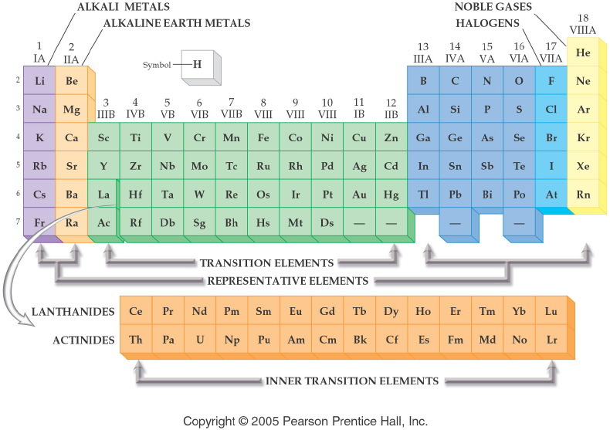

Slide 4
Practice
Identify the following as a halogen, noble gas, alkali metal,alkali earth metal, or transition metal.
Na __________________
Kr __________________
Pt __________________
Be __________________
Cl __________________

Slide 5
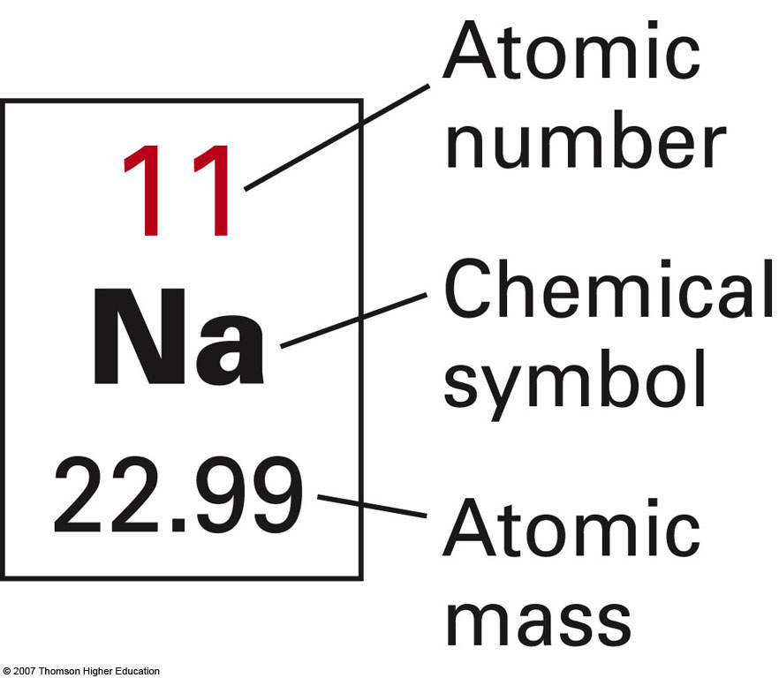

Slide 6
Practice

Slide 7
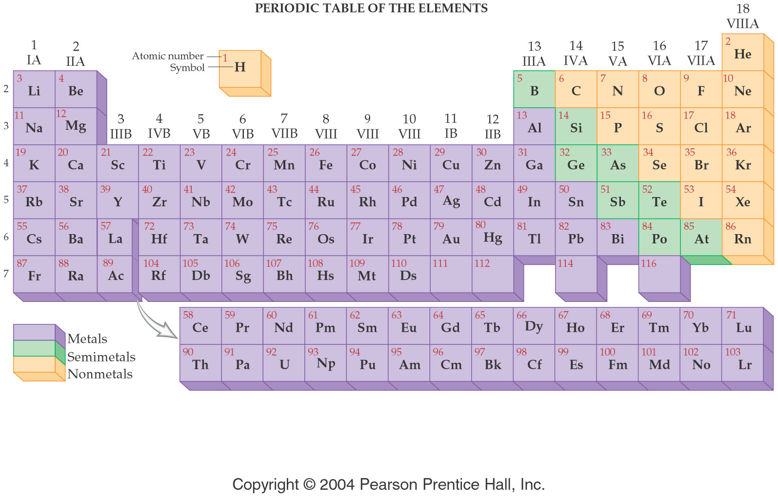

Slide 8
Metallic characters
Metal – shiny, high density, high melting point, great conductor of heat and electricity
Non-metal – dull, low density, low melting point, not good conductor of heat and electricity
Semi-metal – metal-like in appearance and has properties that are between that of a metal and a non-metal.

Slide 9
Atoms are composed of
All matter is composed of the same basic building Blocks, particles called atoms.

Slide 10
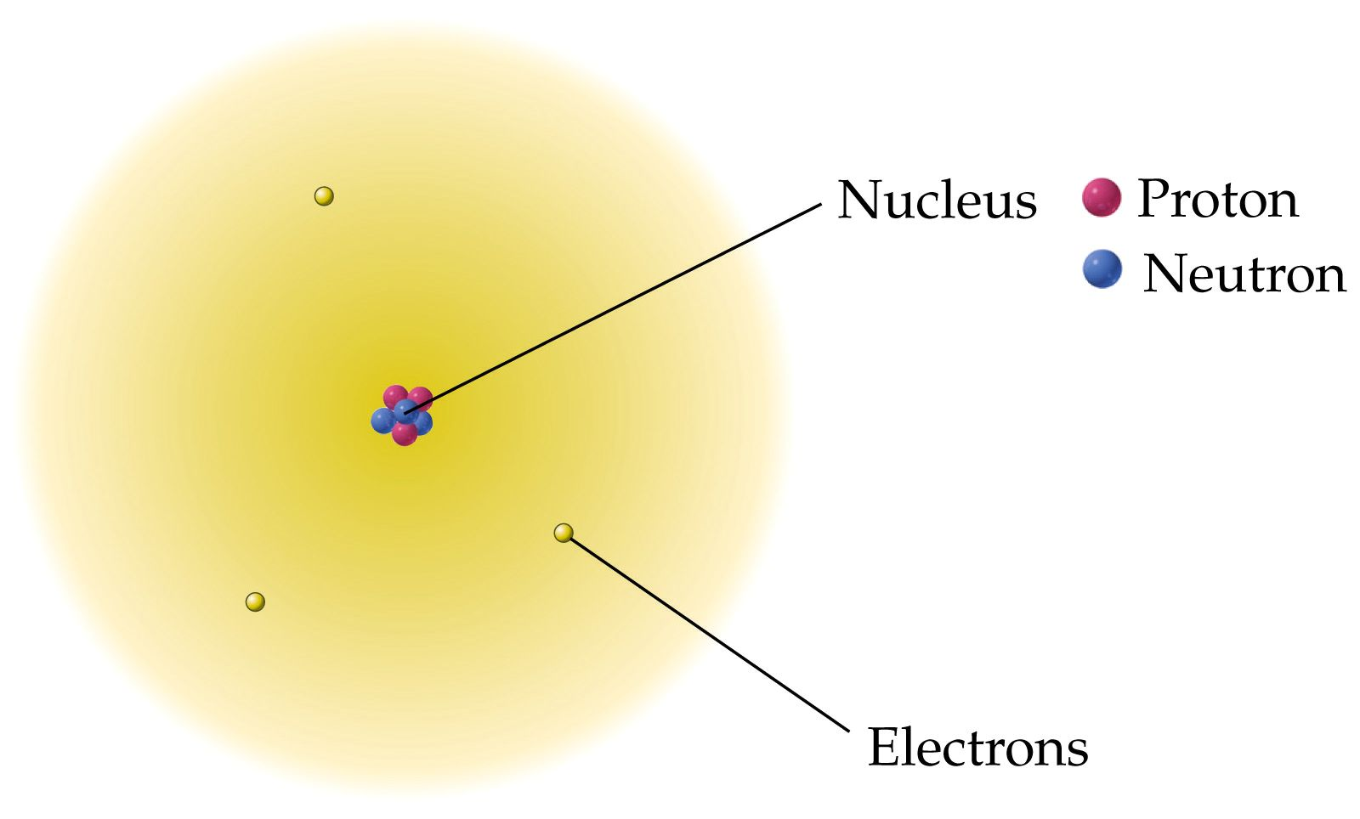
Structure of the Atom

Slide 11
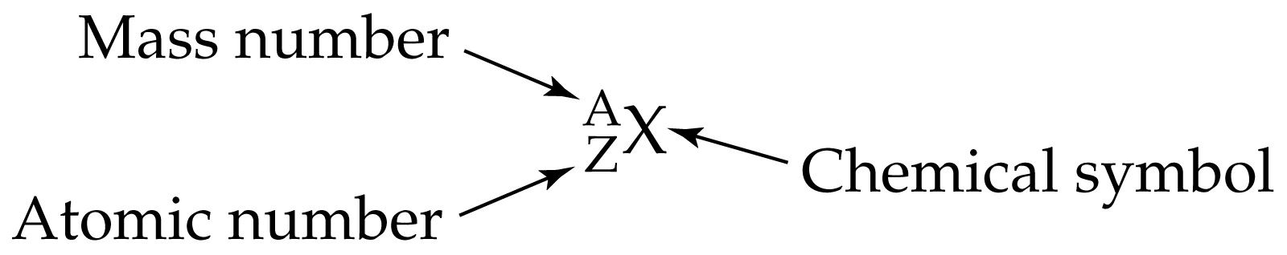
Atomic Notation
Atomic Number = Z
= number of protons in an atom.
= number of electrons in a neutral atom. Mass Number = number protons + number neutrons in an atom

Slide 12
Practice
Element Name | Isotope Symbol | Atomic Number | Mass Number | Number of Protons | Number of Electrons | Number of Neutrons
 | ¹³¹ I
 |  |  |  | 24 | 24
 |  | 26
 |  |  |  |  | 19 | 5

Slide 13
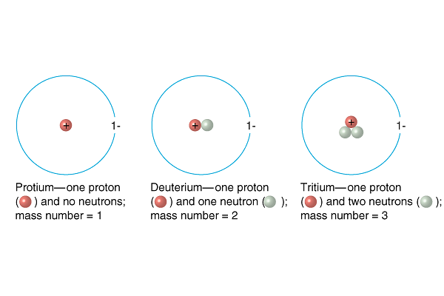
Isotopes
Atoms which differ only in the number of neutrons present in the nucleus.
¹H | ²H | ³H

Slide 14
Atomic Mass
The average relative mass of the isotopes of an element compared to the atomic mass of carbon-12 (exactly 12 amu)
Atomic mass unit (amu)
  1/12 the mass of a carbon-12 atom
  1.6606 x 10⁻²⁴ g

Slide 15
Calculating the Average Atomic Mass
From the Isotopes of Neon

Slide 16
Radioactivity
Radioactive –Spontaneously emitted radiation from the nucleus of an element
radioactive isotopes or radioisotopes- Isotopes that undergo this decay
radioactive decay: Isotopes that are not stable become stable by spontaneously emitting radiation from their nuclei

Slide 17
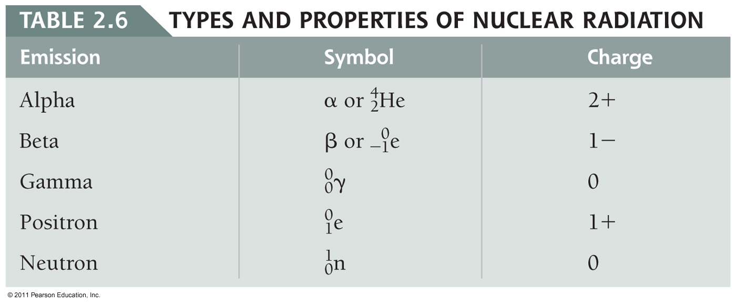
Types of Radiation

Slide 18
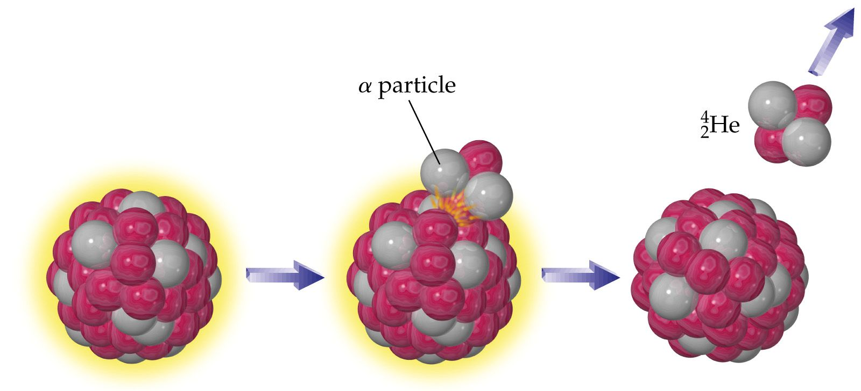
Alpha Emission
alpha particle

Slide 19
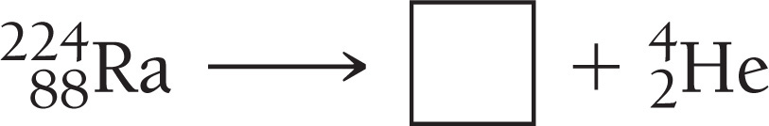
Practice
Pu-239 (plutonium 239) loses an alpha particle (He nucleus). Write the nuclear reaction

Slide 20
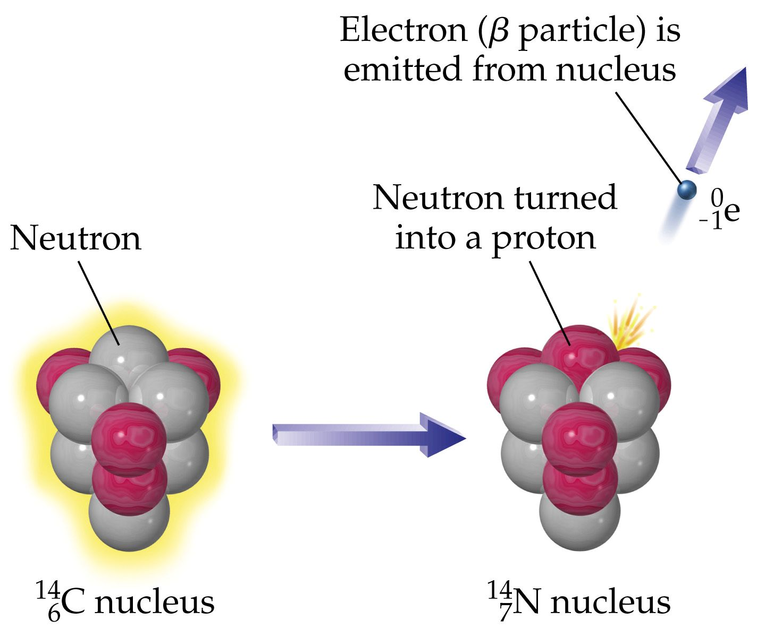
Beta emission

Slide 21
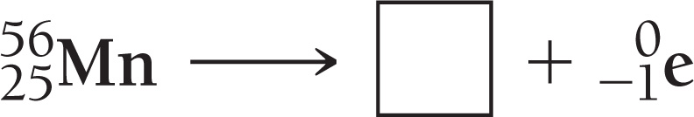
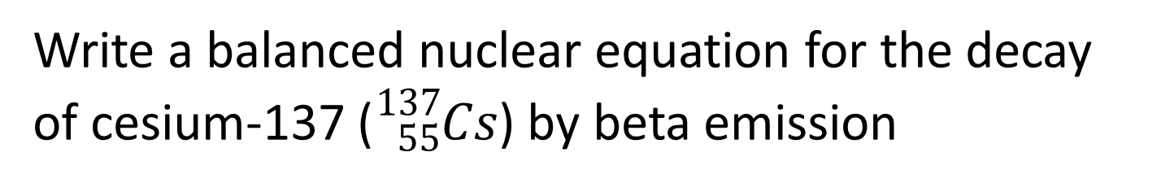
Practice
Write a balanced nuclear equation for the decay of cesium-137 (${}_{55}^{137}{Cs}$) by beta emission

Slide 22
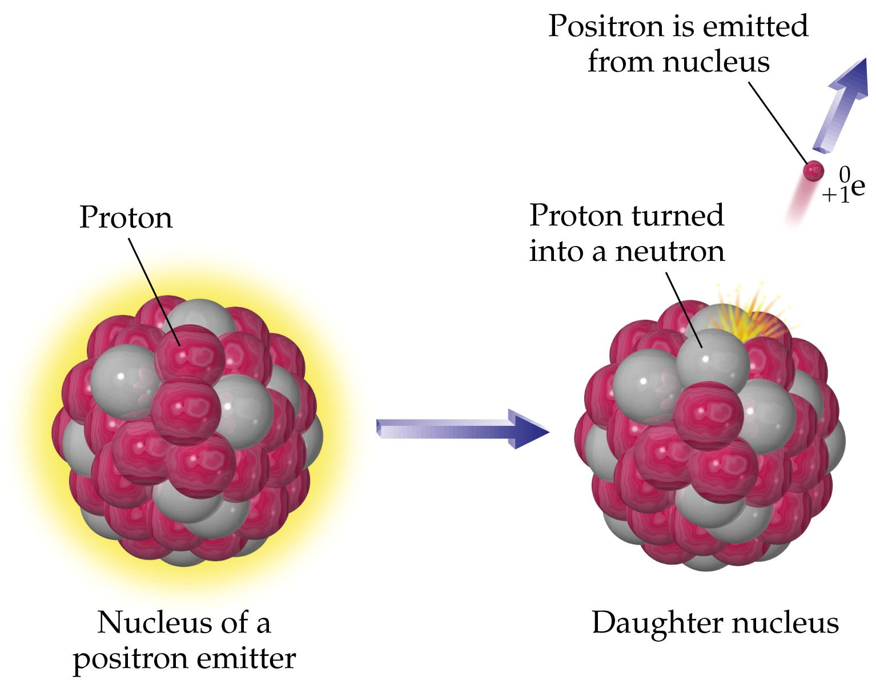
positron emission
positron emission: A proton kicks out positive charge (a positron, β+) to become a neutron

Slide 23
electron capture (EC)
gamma emission

Slide 24
Practice
Write the symbols for an alpha particle, beta particle, gamma ray, and positron.
Alpha particle =
Beta particle =
Positron =
Gamma ray =

Slide 25
Practice
The alpha decay of iridium-174
The beta decay of platinum-199
Positron emission from sulfur-31
Krypton-76 undergoes electron capture

Slide 26
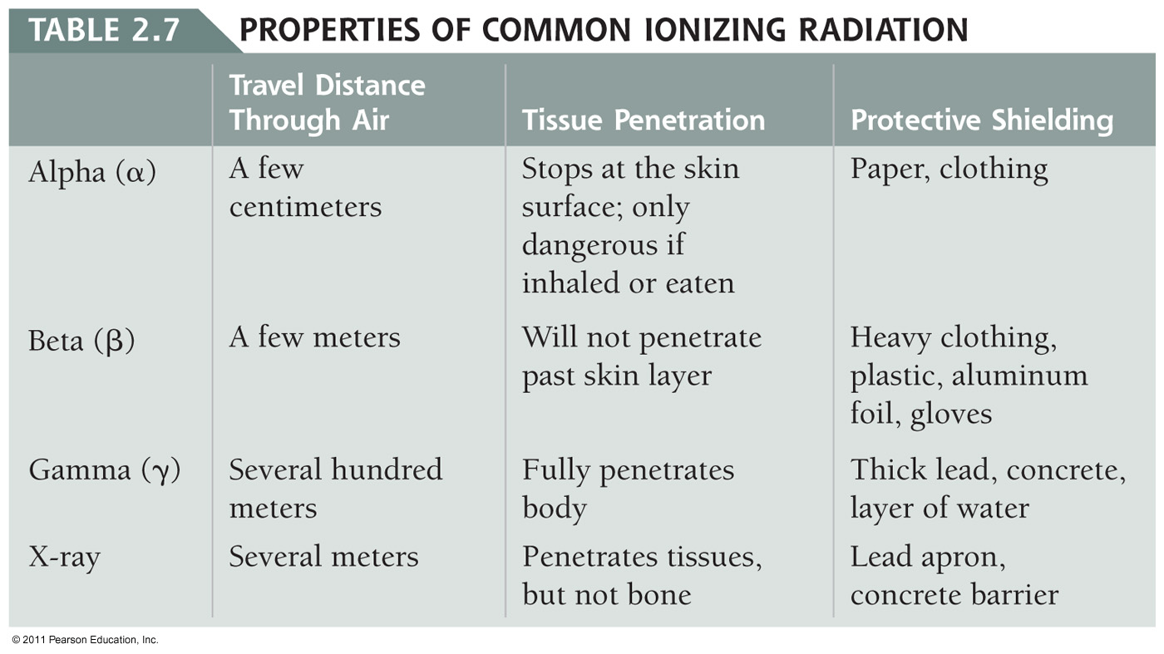
Properties of Nuclear Radiation

Slide 27
Producing Radioactive Isotopes
Nuclear Bombardment – shoot a high energy particle at the nucleus of another atom and watch what happens
Transmutation – changing one element to another by shooting a nuclear particle at its nucleus

Slide 28
Half-Life
The half-life of an isotope is the time it takes for 50% of the atoms in a radioactive sample to decay.
Radioactive activity is measured by “counting’” the number of disintegrations (per second).
The unit for disintegrations is called a curie (Ci)

Slide 29
Radiation Units

Slide 30
Practice
Iodine-131 has half-life of 8 days. If a dose of 200 μCi is given, how much activity remains after 32 days?
How much activity remains after 48 hours?
  Tc-99 half-life = 6 hours (Dose = 25 mCi )

Slide 31
Radioisotopes for Medicine
Naturally occurring radioisotopes have long half-lives.
Medically useful radioisotopes have shorter half-lives: rapid depletion avoids excess tissue damage.
Medical radioisotopes have two main uses:
Diagnosing illness
Irradiating tumors

Slide 32
Thyroid Diagnosis
When radioactive iodine-123 is injected into the body, the isotope is absorbed by the thyroid gland.
The “cold spot” is a tissue region that has low absorption which indicates tissue damage.
A “hot spot” often indicates a region of excessive activity such as rapid mitosis indicating a cancerous tissue.

Slide 33
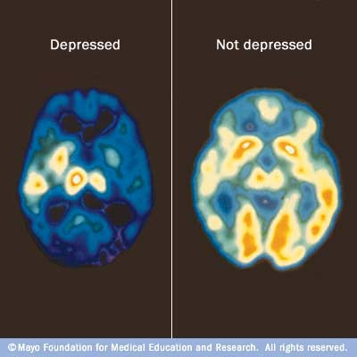
Medical Applications of Radioisotopes
    PET – Positron Emission Tomography
    Patient fed radio-labeled glucose and it goes to where there is lots of metabolic activity. This often indicates a region of brain activity.

Slide 34
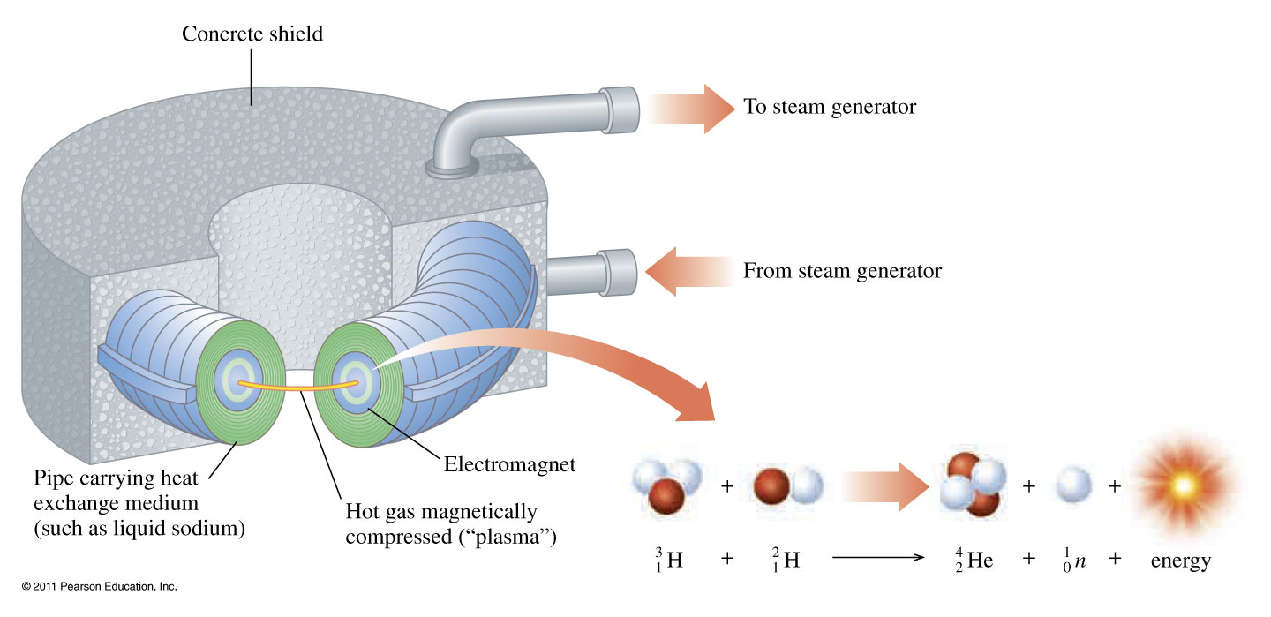
Fusion and Fission
nuclear fusion: small nuclei are combined to form a larger nucleus – this process releases a very large amount of energy, and is the main source of energy in the sun.

Slide 35
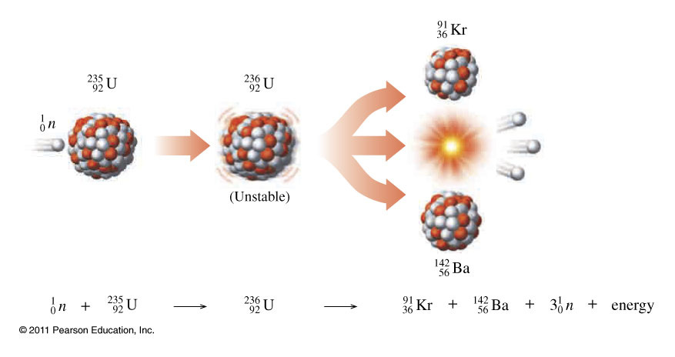
Fission
nuclear fission, large nuclei break apart to form smaller ones, releasing a large amount of energy. Fission is used in nuclear power plants to generate energy.

